Slide 1
Opioid Crisis
Joshua Baranski
University of Illinois at Chicago

Slide 2

Hypothesis
H₀:The population of opioid medication usage does not correlate with high pain scores, a family history of opiate usage and were not confined to a specific age range.
H₁: The population of opioid medication usage does correlate with high pain scores, a family history of opiate usage and were of a specific age range.
This Photo by Unknown Author is licensed under CC BY

Slide 3
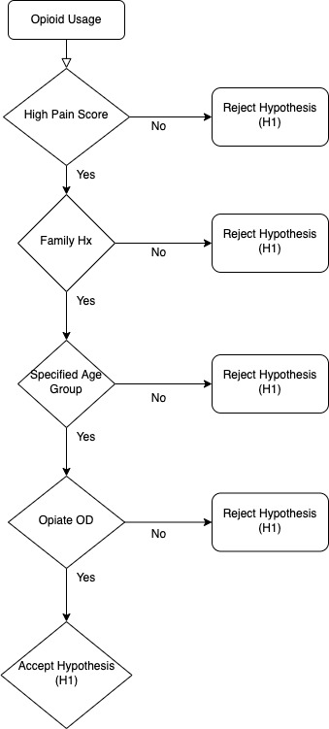
Hypothesis Testing

Slide 4
Implementation of Output
The utilization of a clinical decision support system will be implemented address opioid medication usage with family history, high pain score, patients ranging of 45-65 years age.
Alerts of patients in this population will be generated to the physician to prescribe alternative non-opioid medications.
This data will be analyzed to determine if there is a significant effect in reducing opioid overdoses in this rural community as a pilot study.
The success of the pilot study this system can be extrapolated to larger communities across the country.

Slide 5
Conclusions
Average pain scores was highly related to opioid usage and overdose.
Highest opioid usage was between 45-64 years of age.
Family history was related with opioid usage.
Opioid overdose was related to opioid usage.
Data replications between variables points to value in data collection measures for ongoing data analysis.

